Slide 1


Girraj Government College
B.Nithish Singh
210550054661015
MSDS 3rd year
K.Akshaya
210550054661052
MSDS 3rd year
G-Tech 3.0
P.Ajay
210550054671039
MSCS 3rd year
B.Ravikiran
210550054661013
MSDS 3rd year
One stop destination for all your learning process
D.Sohamprakash
210550054661030
MSDS 3rd year
M.Niharika
210550054661059
MSDS 3rd year

Slide 2


G-TECH
What do you want?

Slide 3
G-TECH
Outline
01 | WHAT IS G-TECH 3.0 ?
02 | AIMS AND OBJECTIVES
03 | SCOPE OF THE PROJECT
04 | PROJECT SPECIFICATION
05 | SYSTEM CONFIGURATION
What we'll cover in this

Slide 4
G-TECH
Outline
06 | FEATURES
07 | SYSTEM ANALYSIS AND DESIGN
08 | ROLES OF PROPOSED SYSTEM
09 | PRACTICAL
10 | CONCLUSION
What we'll cover in this

Slide 5
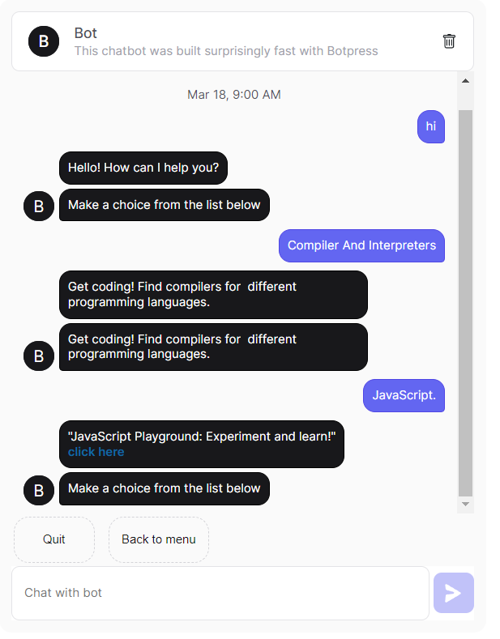

G-TECH
WHAT IS G-TECH 3.0?
Gtech 3.0 is a chatbot for the online website called G-tutor which offers a wide range of educational materials, including notes, cheatsheets, and projects ideas, serving students' diverse needs.
Gtech is optimized for learning, testing, and training

Slide 6



G-TECH
AIMS AND OBJECTIVES
01 Our Aim is to provide a easyway to get rid of the confusion to start your programming journey with roadmaps, cheatsheets, compilers, notes all at one place ,so we developed this "G-tech 3.0". | 02 To reduce information overload and save students' time by providing quick and relevant assistance by implementing a conversational bot.

Slide 7



G-TECH
WHY G-TECH 3.0?
In this era, skill is very important for any student but the real problem to gain knowledge is not lack of information but, the real problem is information overload.
We have lots of sources in the internet which creates a confusion.
To overcome these problems we thought of introducing a bot called G-Tech 3.0.

Slide 8



G-TECH
Developing an intelligent bot, G-Tech 3.0, to assist students in navigating G-Tutor.
The website improves the efficiency study of students and saves time while browsing.
One website can serve many things at a time but one chatbot can serve you only what you need at a time.
SCOPE OF THE PROJECT

Slide 9

Project Specifications
G-Tech 3.0 will be a chatbot application
It will utilize Natural Language Processing (NLP) to understand user queries
The bot will be integrated with the G-Tutor 2.0 website

Slide 10


SYSTEM CONFIGURATION
G-TECH
Software requirements
Operating system: Windows
Front-end: HTML, CSS, Bootstrap, javaScript
Back-end: mysql, Javascript, Bot press.
Communication Architecture: ER Model Diagrams.
Client Browsers: Microsoft EDGE, Chrome, Internet Explorer, etc.
Apps: Telegram, Whatsapp.
Internet connectivity

Slide 11

G-TECH
Automated Navigation: The Gtech Bot efficiently navigates through different sections of the website, saving time and effort for users.. | Productivity Enhancement: By automating tasks, the bot enables users to focus on learning and project work, thereby increasing productivity. | Time-Saving Features: The bot's capabilities contribute to a more efficient and streamlined experience for users, allowing them to access resources quickly.

Slide 12
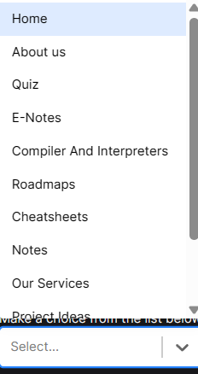
ROLES OF PROPOSED SYSTEM
The main objective of the project develop a fully functional bot which servers the users as smart hub.
G-TECH

Slide 13
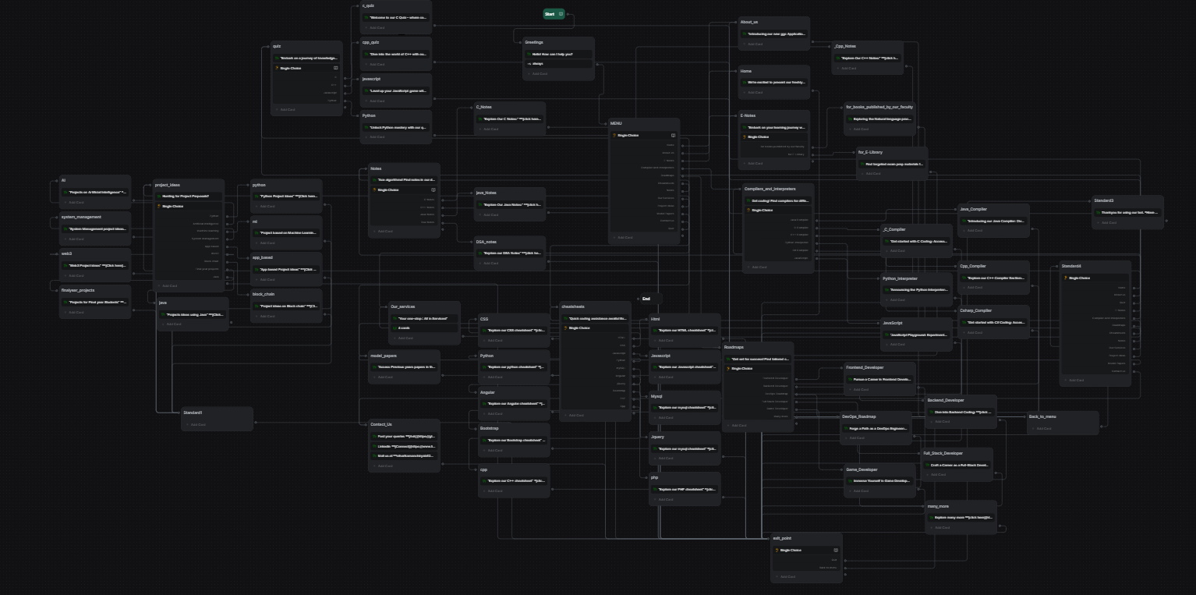
SYSTEM ANALYSIS AND DESIGN

Slide 14

Conclusion
Our website can guide you to your destination
But
Our bot is like a friend who can take you to the Destination
G-TECH

Slide 15
References
https://ndl.iitkgp.ac.in/
https://www.programiz.com/
https://roadmap.sh/
https://cheatography.com/
https://dost.cgg.gov.in/
https://www.eduqfix.com/PayDirect/#/student
G-TECH

Slide 16


With G-Tech 3.0, students can focus on learning and career development without being overwhelmed by information overload.

